Slide 1
SQL Server Query Execution and Plans
Module 7

Slide 2
Learning Units covered in this Module
Lesson 1: SQL Server Query Execution
Lesson 2: SQL Server Query Plan Analysis
Lesson 3: SQL Server Intelligent Query Processing
Notes:
The SQL Server Query Optimizer is a cost-based optimizer. Each possible execution plan has an associated cost in terms of the amount of computing resources used. The Query Optimizer must analyze the possible plans and choose the one with the lowest estimated cost. Some complex SELECT statements have thousands of possible execution plans. In these cases, the Query Optimizer does not analyze all possible combinations. Instead, it uses complex algorithms to find an execution plan that has a cost reasonably close to the minimum possible cost.
The SQL Server Query Optimizer does not choose only the execution plan with the lowest resource cost; it chooses the plan that returns results to the user with a reasonable cost in resources and that returns the results the fastest. For example, processing a query in parallel typically uses more resources than processing it serially, but completes the query faster. The SQL Server Query Optimizer will use a parallel execution plan to return results if the load on the server will not be adversely affected.
The SQL Server Query Optimizer relies on distribution statistics when it estimates the resource costs of different methods for extracting information from a table or index.
The SQL Server Query Optimizer is important because it enables the database server to adjust dynamically to changing conditions in the database without requiring input from a programmer or database administrator. This enables programmers to focus on describing the final result of the query. They can trust that the SQL Server Query Optimizer will build an efficient execution plan for the state of the database every time the statement is run.
Trivial plan optimization
If SQL Server knows that there is only one viable plan for a query, a lot of work can be avoided. For example, where there is only one possible plan:
A query that consists of an INSERT with a VALUES clause.
A SELECT statement for which all the columns are among the keys of a unique composite index, and that index is the only one that is relevant. No other index has that set of columns in it.
The trivial plan query optimizer finds the really obvious plans that are typically very inexpensive. This saves the query optimizer from having to consider every possible plan, which can be costly and can outweigh any benefit provided by well-optimized queries.
Simplification
If there is no trivial plan, SQL Server will perform a simplification. These are usually syntactic transformations of the query itself, to look for commutative properties and operations that can be rearranged. There is no cost or available index analysis. SQL Server then loads up the metadata, including the statistical information on the indexes.
Cost-based optimization
A set of transformation rules is followed that apply various permutations of data access strategies, join orders, aggregation placement, subquery transformations, and other rules that guarantee that a correct result is returned.
Optimization is broken up into three search phases to prevent the process from taking much longer than the execution of the query.
SQL Server evaluates the cost of the cheapest plan after each phase and executes that plan, if the plan is cheap enough. Otherwise, the query optimizer runs the next phase, which involves another set of usually more complex rules.
Phase 0 – Transactional Processing Phase: Contains a very limited set of rules and is applied only to simple queries with three or fewer tables. A limited number of join orders are evaluated, which may generate many potential plan candidates. Hash and nested loop join strategies are considered. If a plan with an estimated cost below 0.2 is found, the optimization ends and the query is executed. This phase is also known as the Transaction Processing phase, because query plans produced by this phase are typically found for queries in online transaction processing (OLTP) applications.
Phase 1 – Quick Plan Optimization Phase: More transformation rules and different join orders are evaluated. If the best plan costs less than 1.0, the optimization ends.
The query optimizer has considered only non-parallel execution plans so far. Phase 1 is repeated with the goal of finding the best parallel plan if:
More than one logical CPU is available to SQL Server.
The least expensive plan produced by Phase 1 costs more than the Cost Threshold for Parallelism.
The cost is >= 1.
Phase 2 – Full Optimization Phase: The cost of the serial and parallel plans are compared and Phase 2 is executed for the cheaper plan. Outer join reordering and automatic indexed view substitution for multi-table views are also considered.
An internal timeout can occur and the Query Optimizer stops the optimization process and returns the least expensive plan it has found so far. This timeout event is also shown on the properties of a graphical plan as Reason For Early Termination of Statement Optimization or on an XML plan as StatementOptmEarlyAbortReason.
We should be aware that if the full optimization phase produced a parallel plan for this query, it does not necessarily mean that the plan will be executed on multiple processors. If the machine is very busy, and cannot support running a single query on multiple CPUs, the plan

Slide 3
Lesson 1: SQL Server Query Execution

Slide 4

Objectives
After completing this learning, you will be able to:
Explain Query Compilation and Optimization Process.
Explain Query Execution Process.
Explain Recompilation causes.

Slide 5
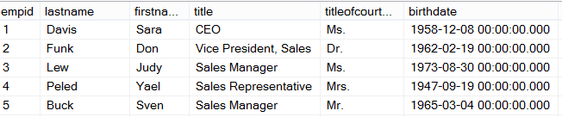
Ad Hoc Query
Stored Procedure
First Execution
or Recompile
Syntax
Parse
Execution Context
Resolve
(Binding)
Compile
Optimize
Execution Plan
Procedure Cache
Compile
Compile
Run Time
Execute
Execute
Execute
Execute
SQL
SQL
Sets
Sets
Notes:
This post will describe how a SQL Server will PROCESS a query. The first time through running an Ad Hoc query or Stored Procedure, SQL Server will go through each of the following steps.
The first step is to Parse the statement into keywords, expressions, and operators. This is where the syntax of your query statement is checked for accuracy. Both the first and second steps are where you will find syntax errors. In most cases, these errors are caused by misspellings or putting commas in the wrong place.
The second step is to Resolve object names (Tables, Views, Columns, etc.) to see if they exist. This step also resolves aliases of columns and tables, as well as, resolves data types and performs implicit data type conversions. As a side note, if you read other blog posts, this step is technically called the Binding phase. I personally call this step the Resolving phase to help spell the word PROCESS as a memorization tool and also to fit the steps on a single slide during presentations.
The third step is to Optimize the query. This is where the query optimizer will find different ways of locating data from your tables based on available indexes and/or statistics. Once it figures a good enough plan to retrieve your result set using the least amount of resources, it will create an Execution Plan. Errors would only occur during this stage if there is a lack of hardware resources. Most compile errors happen at the next step.
The fourth step is to Compile the Execution Plan and store it in the Procedure Cache for future use.
Finally, the Execution Plan is passed to the Storage Engine to Execute the query and hopefully return the desired SQL Sets. This is where Run-Time errors will occur that need to be managed by using Exception Handling. (SQL Sets are normally called recordsets or rowsets, but I’m making a blog post on the PROCESS of queries not the PBOCERS of queries).
Additional submissions of the query from a Stored Procedure, will check the Procedure Cache for existing or similar Execution Plans that could be re-used for the query. If this is the case, the existing Execution Plan will be used to retrieve the SQL Sets using the Execution Context of the Stored Procedure.
It is possible for an Ad Hoc query to also re-use an existing plan from the procedure cache if the only thing that has changed in the query is the parameter value. Example: If a query had been written WHERE ProductID = 732 and was re-written WHERE ProductID = 738 the execution plan could be re-used, but if anything else changed, even by adding a space, the optimizer would compile a new execution plan.
One final thing. You will notice that you can have both an Estimated Execution Plan and an Actual Execution Plan. The difference is the first will show you what the plan would look like before the plan is compiled and the second will additionally add the values of actually running the plan that was placed in the procedure cache and executed.

Slide 6
What does the binding step resolve?
Resolve aliases of columns and tables
Data types and if implicit data type conversions are needed.
Object names (Tables, Views, Columns, etc.) to see if they exist.
User permissions are checked.
Does a cached plan exist?
Notes:
This post will describe how a SQL Server will PROCESS a query. The first time through running an Ad Hoc query or Stored Procedure, SQL Server will go through each of the following steps.
The first step is to Parse the statement into keywords, expressions, and operators. This is where the syntax of your query statement is checked for accuracy. Both the first and second steps are where you will find syntax errors. In most cases, these errors are caused by misspellings or putting commas in the wrong place.
The second step is to Resolve object names (Tables, Views, Columns, etc.) to see if they exist. This step also resolves aliases of columns and tables, as well as, resolves data types and performs implicit data type conversions. This is also where user permissions are checked and if any cached plans exist. As a side note, if you read other blog posts, this step is technically called the Binding phase. I personally call this step the Resolving phase to help spell the word PROCESS as a memorization tool and also to fit the steps on a single slide during presentations.
The third step is to Optimize the query. This is where the query optimizer will find different ways of locating data from your tables based on available indexes and/or statistics. Once it figures a good enough plan to retrieve your result set using the least amount of resources, it will create an Execution Plan. Errors would only occur during this stage if there is a lack of hardware resources. Most compile errors happen at the next step.
The fourth step is to Compile the Execution Plan and store it in the Procedure Cache for future use.
Finally, the Execution Plan is passed to the Storage Engine to Execute the query and hopefully return the desired SQL Sets. This is where Run-Time errors will occur that need to be managed by using Exception Handling. (SQL Sets are normally called recordsets or rowsets, but I’m making a blog post on the PROCESS of queries not the PBOCERS of queries).
Additional submissions of the query from a Stored Procedure, will check the Procedure Cache for existing or similar Execution Plans that could be re-used for the query. If this is the case, the existing Execution Plan will be used to retrieve the SQL Sets using the Execution Context of the Stored Procedure.
It is possible for an Ad Hoc query to also re-use an existing plan from the procedure cache if the only thing that has changed in the query is the parameter value. Example: If a query had been written WHERE ProductID = 732 and was re-written WHERE ProductID = 738 the execution plan could be re-used, but if anything else changed, even by adding a space, the optimizer would compile a new execution plan.
One final thing. You will notice that you can have both an Estimated Execution Plan and an Actual Execution Plan. The difference is the first will show you what the plan would look like before the plan is compiled and the second will additionally add the values of actually running the plan that was placed in the procedure cache and executed.

Slide 7


Yes
Trivial Plan?
Query Plan Created
Phase 2
Compare Plans and Full Optimization
No
Phase 1b
Quick Parallel Plans
Query Optimizer Phases
Yes
No
Simplification and Statistics
Yes
No
Cost < 1.0
or
MAXDOP = 1
Cost > Cost Threshold for Parallelism
Yes
Simple Query Tables <= 3
Cost < 0.2
Phase 0 Transactional Processing
No
Phase 1a
Quick Serial Plans
Notes:
The SQL Server Query Optimizer uses cost-based optimization to create an execution plan with the least cost, but that also consumes the least amount of resources. The Query Optimizer will not evaluate all possible combinations of plans but will create a “Good Enough” plan based on available information such as statistics and the data distribution.
Trivial Plan Optimization: The Query Optimizer goes through several phases in the process of query optimization. First it must determine if the query has a trivial plan. Specially, a query that has only one plan to consider, such as, a SELECT statement where all the columns can be found in a single table or index. If a trivial plan is found, this saves the query optimizer from having to evaluate multiple plans, which reduces the workload of the optimizer. If a trivial plan is discovered then the optimization ends, and the query plan is created.
Non-Trivial Plan Optimization: When a trivial plan is unable to be generated, the query optimizer performs a simplification process to try to discover if unnecessary joins can be removed, operations can be rearranged, or commutative properties folded (Instead of 5 + 6, use 11 as a value). Additionally, before moving on to the next step, statistics, data distribution, and index metadata are added to the query tree.
Cost-based optimization: Now the query optimizer will evaluate the query across three search phases to quickly identify the plan with the least cost.
Phase 0 – Transactional Processing Phase: When online transaction processing (OTLP) queries are evaluated and there are three tables or less, the optimizer evaluates a limited number of join operators (merge, hash match, or loop) for potential plan candidates. If the estimated cost is less than 0.2 then the optimization ends, and the query plan is created.
Phase 1a – Quick Serial Plan Optimization: Additional join orders and transformation rules are evaluated to create a cost-effective serial plan. If the plan cost is less than 1.0 then the optimization ends, and the query plan is created.
Phase 1b – Quick Parallel Plan Optimization: At this point, if the cost of the plan is greater than 1.0, MAXDOP is set to a value greater than 1, and the plan cost is greater than the Cost Threshold for Parallelism; then the query optimizer repeats Phase 1 until it finds the most efficient parallel plan.
Phase 2 – Compare Plans and Full Plan Optimization: At this point the serial plan that had a cost greater than 1.0 but less than the Cost Threshold for Parallelism is compared with the most efficient parallel plan. The optimizer will then take the cheaper of the two plans and consider if there are any additional ways of optimizing the ·execution plan. At this point, the optimization ends, and the query plan is created.

Slide 8
Query Simplification phases
Constant Folding: Expressions with constant values are reduced
Quantity = 2 + 3 becomes Quantity = 5
10 < 20 becomes True
Contradiction Detection: Removes criteria that doesn’t match table constraints
Constraint: Age > 18
Contradiction: WHERE Age < 18
Domain Simplification: Reduces complex ranges to simple ranges
Complex range: ID > 10 and ID < 20 or ID > 30 and < 50
Simplified range: ID > 10 and < 50
Join Simplification: Removes redundant joins that are not necessary
Predicate Pushdown: Perform calculations only on rows returned
Notes:
The SQL Server Query Optimizer uses cost-based optimization to create an execution plan with the least cost, but that also consumes the least amount of resources. The Query Optimizer will not evaluate all possible combinations of plans but will create a “Good Enough” plan based on available information such as statistics and the data distribution.
Trivial Plan Optimization: The Query Optimizer goes through several phases in the process of query optimization. First it must determine if the query has a trivial plan. Specially, a query that has only one plan to consider, such as, a SELECT statement where all the columns can be found in a single table or index. If a trivial plan is found, this saves the query optimizer from having to evaluate multiple plans, which reduces the workload of the optimizer. If a trivial plan is discovered then the optimization ends, and the query plan is created.
Non-Trivial Plan Optimization: When a trivial plan is unable to be generated, the query optimizer performs a simplification process to try to discover if unnecessary joins can be removed, operations can be rearranged, or commutative properties folded (Instead of 5 + 6, use 11 as a value). Additionally, before moving on to the next step, statistics, data distribution, and index metadata are added to the query tree.
Cost-based optimization: Now the query optimizer will evaluate the query across three search phases to quickly identify the plan with the least cost.
Phase 0 – Transactional Processing Phase: When online transaction processing (OTLP) queries are evaluated and there are three tables or less, the optimizer evaluates a limited number of join operators (merge, hash match, or loop) for potential plan candidates. If the estimated cost is less than 0.2 then the optimization ends, and the query plan is created.
Phase 1a – Quick Serial Plan Optimization: Additional join orders and transformation rules are evaluated to create a cost-effective serial plan. If the plan cost is less than 1.0 then the optimization ends, and the query plan is created.
Phase 1b – Quick Parallel Plan Optimization: At this point, if the cost of the plan is greater than 1.0, MAXDOP is set to a value greater than 1, and the plan cost is greater than the Cost Threshold for Parallelism; then the query optimizer repeats Phase 1 until it finds the most efficient parallel plan.
Phase 2 – Compare Plans and Full Plan Optimization: At this point the serial plan that had a cost greater than 1.0 but less than the Cost Threshold for Parallelism is compared with the most efficient parallel plan. The optimizer will then take the cheaper of the two plans and consider if there are any additional ways of optimizing the ·execution plan. At this point, the optimization ends, and the query plan is created.

Slide 9
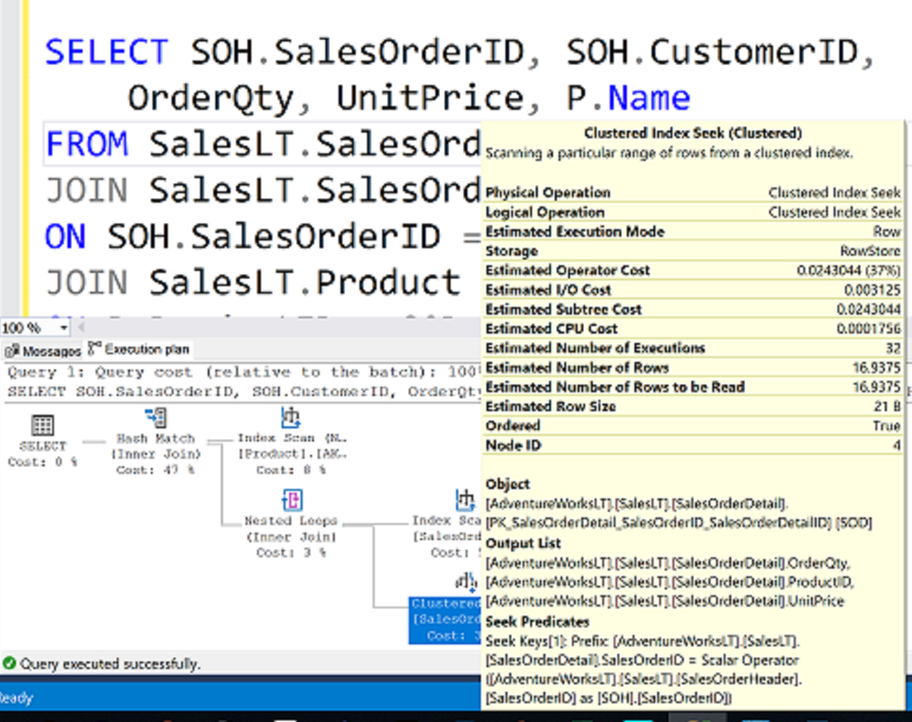
What is an Execution Plan?

Slide 10
How to see the query plan
Graphical execution plan
Estimated Execution Plan (Before Execution)
Live Query Statistics (During Execution)
Actual Execution Plan (After Execution)
The compiled plan.
The same as the compiled plan plus its execution context.
The same as the compiled plan plus its execution context.
This includes runtime information available after the execution completes, such as execution warnings, or in newer versions of the Database Engine, the elapsed and CPU time used during execution.
This includes runtime information during execution progress and is updated every second. Runtime information includes for example the actual number of rows flowing through the operators.
Enables rapid identification of potential bottlenecks.

Slide 11
SQL Server Execution Plan
Execution modes
Row mode execution
Batch mode execution
Efficient for Data Warehousing scenarios
Efficient for OLTP scenarios
Operators read all columns from qualifying rows based on predicate, and for each row it retrieves columns needed for the result set
Used to process multiple rows together
Closely integrated with, and optimized around the ColumnStore storage format
Operators read only the columns required for the result, from group of rows together.
Used with traditional tables, where data is stored in row-wise format.
Starting SQL Server 2019, Batch mode does not require a ColumnStore index as in the previous versions.
Notes:
Execution modes
The SQL Server Database Engine can process Transact-SQL statements using two distinct processing modes:
Row mode execution
Batch mode execution
Row mode execution
Row mode execution is a query processing method used with traditional RDMBS tables, where data is stored in row format. When a query is executed and accesses data in row store tables, the execution tree operators and child operators read each required row, across all the columns specified in the table schema. From each row that is read, SQL Server then retrieves the columns that are required for the result set, as referenced by a SELECT statement, JOIN predicate, or filter predicate.
Row mode execution is very efficient for OLTP scenarios, but can be less efficient when scanning large amounts of data, for example in Data Warehousing scenarios.
Batch mode execution
Batch mode execution is a query processing method used to process multiple rows together (hence the term batch). Each column within a batch is stored as a vector in a separate area of memory, so batch mode processing is vector-based. Batch mode processing also uses algorithms that are optimized for the multi-core CPUs and increased memory throughput that are found on modern hardware.
Batch mode execution is closely integrated with, and optimized around, the ColumnStore storage format. Batch mode processing operates on compressed data when possible and eliminates the exchange operator used by row mode execution. The result is better parallelism and faster performance.
When a query is executed in batch mode, and accesses data in ColumnStore indexes, the execution tree operators and child operators read multiple rows together in column segments. SQL Server reads only the columns required for the result, as referenced by a SELECT statement, JOIN predicate, or filter predicate. Batch mode execution is very efficient in Data Warehousing scenarios, where large amounts of data are read and aggregated.
For further information refer to:
https://docs.microsoft.com/en-us/sql/relational-databases/query-processing-architecture-guide

Slide 12
SQL Server Execution Plan
Main components
Compiled Plan (or Query Plan)
Compilation produces a query plan, which is a read-only data structure used by any number of users.
Execution Context
A data structure used to hold information specific to a query execution, such as parameter values.
Parameter A = ? Parameter B = ? User = ?
Parameter A = 12 Parameter B = ‘xy’ User = Jorge
Parameter A = 100 Parameter B = ‘ftr’ User = Nabil
Parameter A = 11 Parameter B = ‘sd’ User = Walter
Query Plan
Execution Context 1
Execution Context 2
Execution Context 3
Notes:
A query plan is the actual method that SQL Server uses to access data. While a Transact-SQL (T-SQL) statement indicates what the request is, the query plan indicates how to run the request.
Logical operators describe the relational algebraic operation used to process a statement. In other words, logical operators describe conceptually what operation needs to be performed.
Physical operators actually implement the operation defined by a logical operator using a concrete method or algorithm. For example, join is a logical operation, whereas nested loops join is a physical operator.
A Query Plan:
Is also known as an Execution Plan.
Is a re-entrant, read-only data structure used by any number of users.
Contains the data access strategy for the query.
Does not store any user context.
Is never stored more than twice in memory. There is one copy for all serial executions and possibly one copy for all parallel executions. The parallel copy covers all parallel executions, regardless of their degree of parallelism.
An Execution Context is derived from a query plan. Execution contexts:
Hold the values needed for a specific execution of a query plan.
Are cached and reused.
Are created for each user concurrently executing a batch and will hold data (such as parameter values) specific to their execution.
Are not re-entrant. At any point of time, an execution context can be executing only one batch submitted by a session, and while the execution is happening, the context is not given to any other session or user.

Slide 13
SQL Server Execution Plan Caching
Overview
Part of the memory pool used to store execution plans – also known as plan cache.
The plan cache has two stores for all compiled plans:
The Object Plans cache store (OBJCP)
used for plans related to persisted objects (stored procedures, functions, and triggers).
The SQL Plans cache store (SQLCP)
used for plans related to autoparameterized, dynamic, or prepared queries.
Notes:
For further information refer to:
https://docs.microsoft.com/en-us/sql/relational-databases/query-processing-architecture-guide

Slide 14
SQL Server compilation and execution
Concepts
Compilation
Process of creating a good enough query execution plan, as quickly as possible for a query batch.
Refer to both the compilation of non-DML constructs in SQL statements (control flow, DDL, etc.) and the process of Query Optimization.
Query Execution
Process of executing the plan that is created during query compilation and optimization.
Notes:
For further information refer to:
https://docs.microsoft.com/en-us/sql/relational-databases/query-processing-architecture-guide

Slide 15
SQL Server Execution Plan Recompilations
Overview
Most recompilations are required either for statement correctness or to obtain potentially faster query execution plan.
The engine detects changes that invalidate execution plan(s) and marks those as not valid. New plan must be recompiled for the next query execution.
Starting with SQL Server 2005, whenever a statement within a batch causes recompilation, only the statement inside the batch that triggers recompilation is recompiled.
Notes:
For further information refer to
https://docs.microsoft.com/en-us/sql/relational-databases/query-processing-architecture-guide
Plan Caching and Recompilation in SQL Server 2012 - https://docs.microsoft.com/en-us/previous-versions/sql/sql-server-2012/dn148262(v=msdn.10)

Slide 16
SQL Server Execution Plan Recompilations
Recompilation reasons
Table / Index Changes
Changes made to objects referenced by the query (ALTER TABLE and ALTER VIEW).
Changing or dropping any indexes used by the execution plan.
Stored Procedures
Changes made to a single procedure, which would drop all plans for that procedure from the cache (ALTER PROCEDURE).
Explicit call to sp_recompile.
Executing a stored procedure using the WITH RECOMPILE option.
Data Volume
Updates on statistics used by the execution plan
For tables with triggers, if the number of rows in the inserted or deleted tables grows significantly.
Other
Large numbers of changes to keys (generated by statements from other users that modify a table referenced by the query).
Temporary table changes

Slide 17

Questions?

Slide 18
Knowledge Check
What is meant by SQL Server’s query optimizer being cost-based?
When is a query considered for a parallel execution plan?
Will SQL Server evaluate every possible query plan in the process of optimization? Why?
Name two recompilation causes.
Notes:
Q: What is meant by SQL Server’s query optimizer being cost-based?
A: Cost-based means that SQL Server tries to optimize queries based on the estimated resources that it will take to run the query.
Q: When is a query considered for a parallel execution plan?
SQL Server will consider a parallel execution plan if more than one logical CPU is available to SQL Server. The least expensive plan produced by Phase 1 costs more than the Cost Threshold for Parallelism.
Q: Will SQL Server evaluate every possible query plan in the process of optimization? Why?
A: No, SQL Server will not consider every possible plan, because in many cases, this could prove to cost more than running the query with a non-optimal plan. SQL Server will choose a plan that is good enough.
Q:Name two recompilation causes.
A: Several possible options
Changes made to a table or view referenced by the query (ALTER TABLE and ALTER VIEW).
Changes made to a single procedure, which would drop all plans for that procedure from the cache (ALTER PROCEDURE).
Changes to any indexes used by the execution plan.
Updates on statistics used by the execution plan (explicitly or generated automatically).
Dropping an index used by the execution plan.
An explicit call to sp_recompile.
Large numbers of changes to keys (generated by statements from other users that modify a table referenced by the query).
For tables with triggers, if the number of rows in the inserted or deleted tables grows significantly.
Executing a stored procedure using the WITH RECOMPILE option.
Temporary table changed.

Slide 19
Lesson 2: SQL Server Query Plan Analysis

Slide 20
Objectives
After completing this learning, you will be able to:
Read execution plans.
Understand logical and physical join operators.
Describe data access.

Slide 21
How to see the query plan
Graphical execution plan
Estimated Execution Plan (Before Execution)
Live Query Statistics (During Execution)
Actual Execution Plan (After Execution)
The compiled plan.
The same as the compiled plan plus its execution context.
The same as the compiled plan plus its execution context.
This includes runtime information available after the execution completes, such as execution warnings, or in newer versions of the Database Engine, the elapsed and CPU time used during execution.
This includes runtime information during execution progress and is updated every second. Runtime information includes for example the actual number of rows flowing through the operators.
Enables rapid identification of potential bottlenecks.

Slide 22
Contents of an Execution Plan
Methods used to extract data from each table.
How data is joined
Use of temporary worktables and sorts
Estimated rowcount, iterations, and costs from each operator
Actual rowcount and iterations
Sequence in which the source tables are accessed.

Slide 23
How to see the query plan
Text and XML
 | Command | Execute query? | Include estimated row counts & stats (Estimated Query Plan) | Include actual row counts & stats (Actual Query Plan)
Text Plan | SET SHOWPLAN_TEXT ON | No | No | No
 | SET SHOWPLAN_ALL ON | No | Yes | No
 | SET STATISTICS PROFILE ON | Yes | Yes | Yes
XML Plan | SET SHOWPLAN_XML ON | No | Yes | No
 | SET STATISTICS PROFILE XML | Yes | Yes | Yes

Slide 24
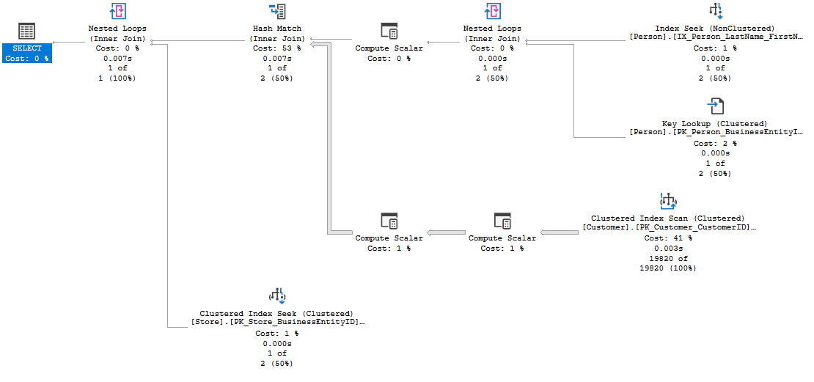

SSMS Graphical Plan
Execution Flow
5
3
1
3
Outer
Table
2
Inner table
4
6
Notes:
The basic guidelines for analyzing a query plan are:
Flow of data is read from right to left.
The width of the arrows gives an indication of the number of rows in each dataset, such as the one coming from the Customer table CL IX scan. This can often be a clue to high resource usage.
For joins:
The outer table appears on top.
Resultsets are created from each join pair, which is then passed to the next join.
Two crucial facts affect join performance:
The order in which more than two tables are joined.
The selection of outer/inner table.
Joins producing smaller result sets are performed first.
Local predicates are applied before the join.
Joins that reduce the number of rows are performed first.
Aggregation may be performed before the join.
This is all dependent on the accuracy of the statistics the Microsoft SQL Server Query processor has at compilation time.
Example Query:
SELECT p.Title + ' ' + p.FirstName + ' ' + p.LastName AS FullName, c.AccountNumber, s.Name
FROM Person.Person AS p
INNER JOIN Sales.Customer AS c ON c.PersonID = p.BusinessEntityID
INNER JOIN Sales.Store AS s ON s.BusinessEntityID = c.StoreID
WHERE p.LastName = 'Koski’
Resultset 1 and 2 are joined using a nested loops join, creating resultset 3.
Resultsets 3 and 4 are joined using a hash match join, creating resultset 5.
Resultsets 5 and 6 are joined using a nested loops join, creating a resultset for the Select clause.

Slide 25
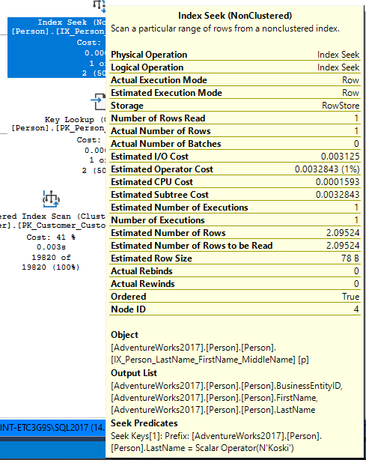
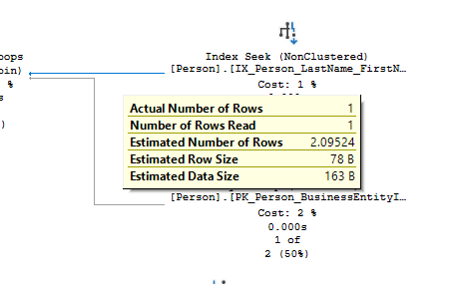
SSMS Graphical Plan
Data flow between the operators and statistical data of each operator
Statistical data for the operator
Data flow statistics
Notes:
Arrows represent the data flow between the iterators.
ToolTips provide detailed help, including a description of statistical data on each iterator; this includes estimates of the number of rows generated by each operator (that is, the cardinality estimates), the average row size, and the cost of the operator.

Slide 26
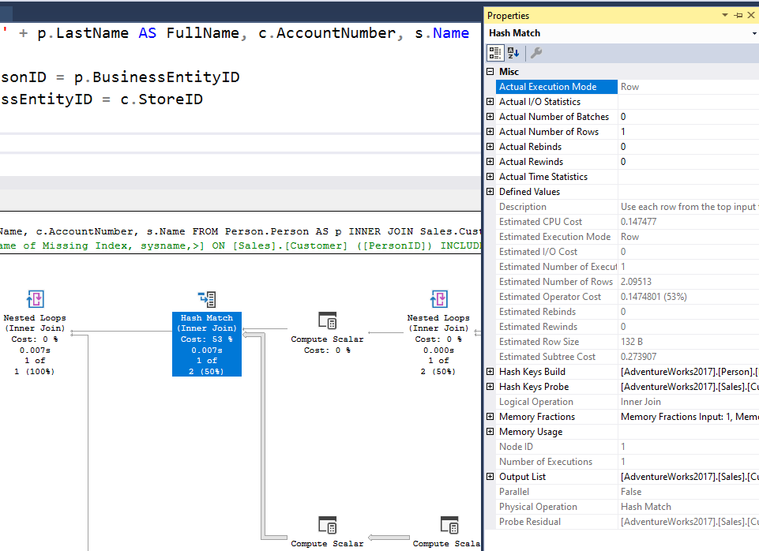
SSMS Graphical Plan
Properties sheet
Management Studio Properties sheet includes even more detailed information about each operator and about the overall query plan.
Use the most recent version of Management Studio as every new version display more detailed information about the Query Plan when examining the plan in graphical mode.
Notes:
The Management Studio Properties sheet includes even more detailed information about each operator and about the overall query plan.

Slide 27
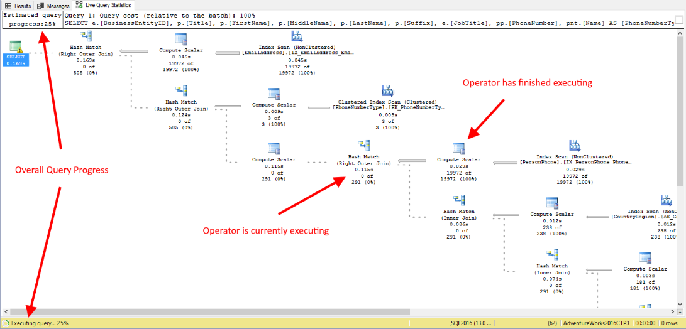
SSMS Graphical Plan
Live Query Statistics
View CPU/memory usage, execution time, and query progress
Allows drill down to live operator-level statistics, such as:
Number of generated rows
Elapsed time
Operator progress
Live warnings
This feature is primarily intended for troubleshooting purposes.
Using this feature can moderately slow the overall query performance.
Notes:
SQL Server Management Studio provides the ability to view the live execution plan of an active query. This live query plan provides real-time insights into the query execution process as the controls flow from one query plan operator to another. The live query plan displays the overall query progress and operator-level run-time execution statistics such as the number of rows produced, elapsed time, operator progress, and so on. Because this data is available in real time without needing to wait for the query to complete, these execution statistics are extremely useful for debugging query performance issues.
This feature is available beginning with SQL Server 2016 (13.x) Management Studio, however it can work with SQL Server 2014 (12.x).
Internally, live query statistics leverages the sys.dm_exec_query_profiles DMV.
To view live query statistics for one query, on the tools menu click the Include Live Query Statistics icon. The live execution plan can also be accessed from the Activity Monitor.
For further information refer to:
https://docs.microsoft.com/en-us/sql/relational-databases/performance/live-query-statistics

Slide 28












Execution Plan
Notable operators
Operators describe how SQL Server executes a query. The query optimizer uses operators to build a query plan to create the result specified in the query.
Table scan
Nonclustered index scan
Clustered index scan
Nonclustered index seek
Clustered index seek
Sort
RID lookup
Table spool
Key lookup
Index spool
ColumnStore Index Scan
Stream Aggregation
Notes:
For further information refer to:
https://docs.microsoft.com/en-us/sql/relational-databases/showplan-logical-and-physical-operators-reference

Slide 29
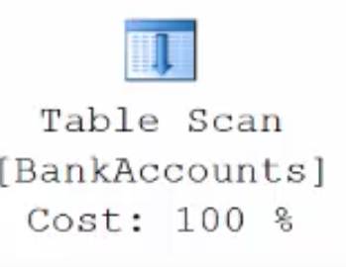
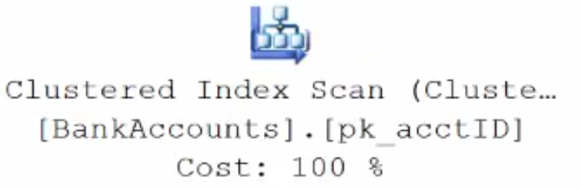
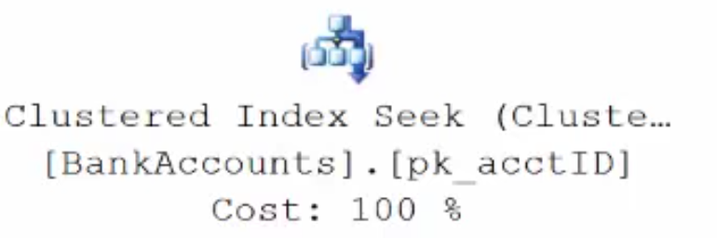
Execution Plan Table Operators
Data stored in a Heap is not stored in any order and normally does not have a Primary Key.
Clustered Index data is stored in sorted order by the Clustering key. In many cases, this is the same value as the Primary Key.
Using a WHERE statement on an Index could possibly have the Execution Plan seek the Index instead of scan.

Slide 30
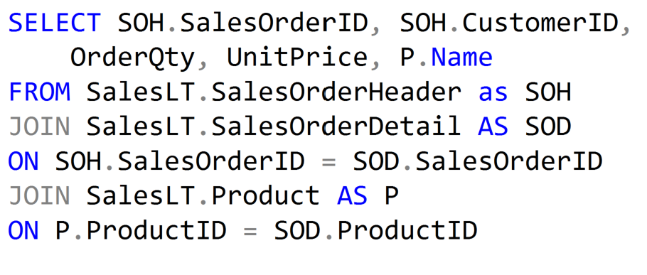
Execution Plan Join Operators (Code)

Slide 31
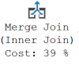
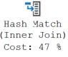
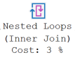
Execution Plan Join Operators
A Merge Join is useful if both table inputs are in the same sorted order on the same value.
A Hash Match is used when the tables being joined are not in the same sorted order.
A Nested Loop is use when a small (outer) table is used to lookup a value in a larger (inner) table.

Slide 32
What to look for in the query plan
Top Left Operator
Expensive Operators
Nested Loop Operator
Scans vs Seeks
Skewed Estimates
Warnings
Data Flow Statistics
Information about possible issues with the plan
Overall properties of the plan
Look from most expensive to least expensive
Thicker arrows mean more data is being passed
Possible to create index that covers query
Not necessarily bad, but could indicate I/O issues
Statistics could be stale or invalid
Sort Operators
Locate why there is a sort operation and is it needed

Slide 33

Demonstration
Query Plan Analysis
Use the graphical execution plan and IO statistics to tune a query.
Explore Live Query Statistics.
Notes:
M07L03Demo01
Go to the Lab VM
Go through e:\Demos\M07L03Demo01\AnalyzingPlanOperators.sql
Go through e:\Demos\M07L03Demo01\LiveQueryStatistics.sql

Slide 34

Query Plan Analysis
Identifying and tuning high cost operators in the query plan
Notes:
M07L03Lab01

Slide 35
Questions?

Slide 36
Knowledge Check
What are the physical join operators?
What is a method to eliminate a lookup?
Is it recommended to eliminate all lookups operators?
Under what circumstances would a table scan be more efficient than an index seek on a non-clustered, non-covering index?
Is a Clustered Index Scan more efficient than a Table Scan?
Notes:
Q1: What are the physical join operators?
A1: The three physical join operators are hash, merge, and loop.
Q2: What is a method to eliminate a lookup?
A2: A lookup can be eliminated with a nonclustered covering index.
Q3:Is it recommended to eliminate all lookups operators?
A3: No, removing all lookup operators could cause that you create big non clustered indexes that can cause index maintenance to be non practical. You must remove lookup operators only when the performance gain will be really significant.
Q4: Under what circumstances would a table scan be more efficient than an index seek on a non-clustered, non-covering index?
A4: If the number of logical reads in a table scan is less than the number of logical reads for a seek and lookup for each row required by an operation.
Q5: Is a Clustered Index Scan more efficient than a Table Scan?
A5: No, even when the plan “uses” an index, the Clustered Index is just the table ordered so it is as bad as a table scan. Consider that the Clustered Index is bigger than the HEAP so scanning the clustered index can cause more IO than scanning the HEAP.

Slide 37
Lesson 3: SQL Server Intelligent Query Processing

Slide 38
Objectives
After completing this learning, you will be able to:
Understand the Intelligent query processing features.
Enable/disable Intelligent query processing features.

Slide 39
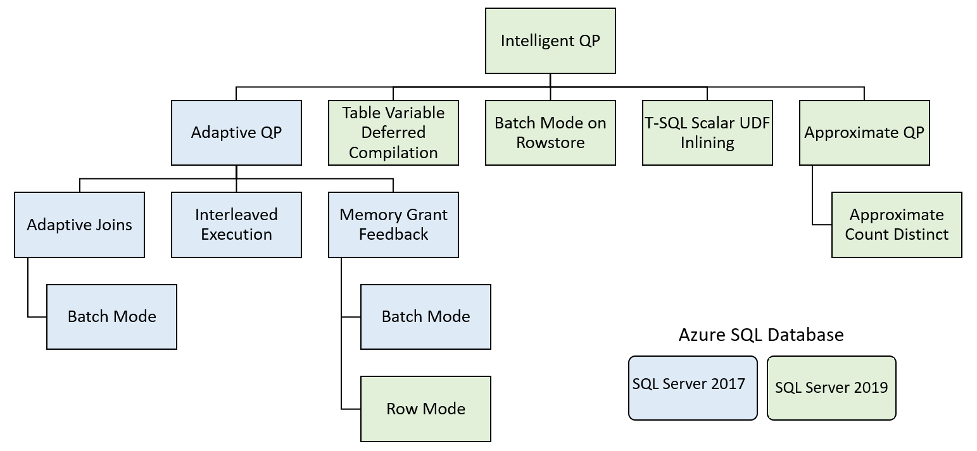
Intelligent query processing
Features family

Slide 40

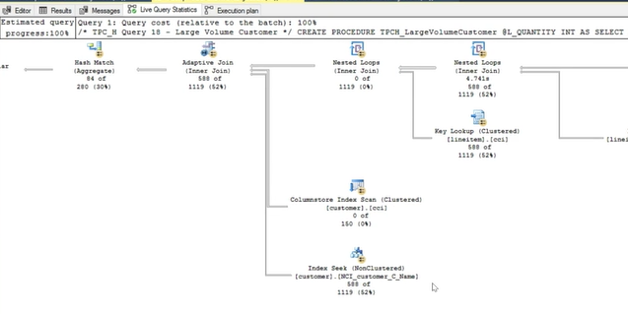
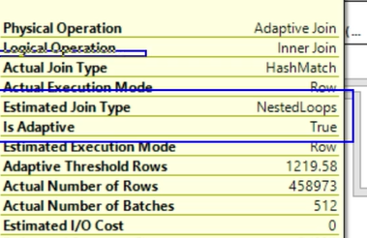
Adaptive joins (Batch mode)
Adaptive join introduction
The choice of a Hash Join or Nested Loops join method is deferred until after the first input has been scanned.
A threshold is used to decide when to switch to a Nested Loops plan, allowing a query plan to use a better join strategy during execution without to be recompiled.
Workloads with frequent oscillations between small and large join input scans will benefit most from this feature.
Notes:
Understanding Adaptive joins
Batch mode Adaptive Joins enable the choice of a Hash Join or Nested Loops join method to be deferred until after the first input has been scanned. The Adaptive Join operator defines a threshold that is used to decide when to switch to a Nested Loops plan. A query plan can therefore dynamically switch to a better join strategy during execution without having to be recompiled.
Tip: Workloads with frequent oscillations between small and large join input scans will benefit most from this feature.
The runtime decision is based on the following steps:
If the row count of the build join input is small enough that a Nested Loops join would be more optimal than a Hash join, the plan switches to a Nested Loops algorithm.
If the build join input exceeds a specific row count threshold, no switch occurs and your plan continues with a Hash join.
Adaptive Join remarks
Adaptive joins introduce a higher memory requirement than an indexed Nested Loops Join equivalent plan. The additional memory is requested as if the Nested Loops was a Hash join. There is also overhead for the build phase as a stop-and-go operation versus a Nested Loops streaming equivalent join. With that additional cost comes flexibility for scenarios where row counts may fluctuate in the build input.
Batch mode Adaptive joins work for the initial execution of a statement, and once compiled, consecutive executions will remain adaptive based on the compiled Adaptive Join threshold and the runtime rows flowing through the build phase of the outer input.
If an Adaptive Join switches to a Nested Loops operation, it uses the rows already read by the Hash Join build. The operator does not re-read the outer reference rows again.
Adaptive join eligible statements
A few conditions make a logical join eligible for a batch mode Adaptive Join:
The database compatibility level is 140 or higher.
The query is a SELECT statement (data modification statements are currently ineligible).
The join is eligible to be executed both by an indexed Nested Loops join or a Hash join physical algorithm.
The Hash join uses Batch mode - either through the presence of a ColumnStore index in the query overall or a ColumnStore indexed table being referenced directly by the join.
The generated alternative solutions of the Nested Loops join and Hash join should have the same first child (outer reference).
For further information refer to:
https://docs.microsoft.com/en-us/sql/relational-databases/performance/joins#adaptive

Slide 41
Adaptive joins (Batch mode)
Enabling/Disabling Adaptive joins
Enabled by default in Compatibility level 140 or higher.
To disable change compatibility level to 130 or lower (not recommended).
You can enable/disable it at the database level in
SQL Server 2017.
Azure SQL Database, SQL Server 2019 and higher
You can disable it at statement scope if necessary.
ALTER DATABASE SCOPED CONFIGURATION SET DISABLE_BATCH_MODE_ADAPTIVE_JOINS = ON|OFF;
ALTER DATABASE SCOPED CONFIGURATION SET BATCH_MODE_ADAPTIVE_JOINS = ON|OFF;
<statement>
OPTION (USE HINT('DISABLE_BATCH_MODE_ADAPTIVE_JOINS'));

Slide 42
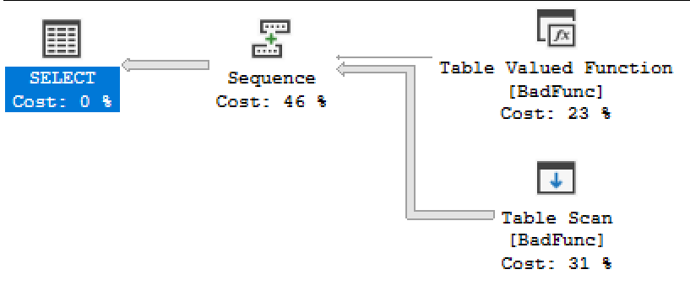
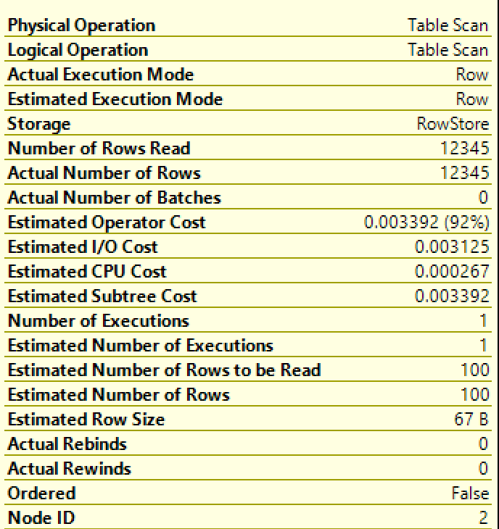
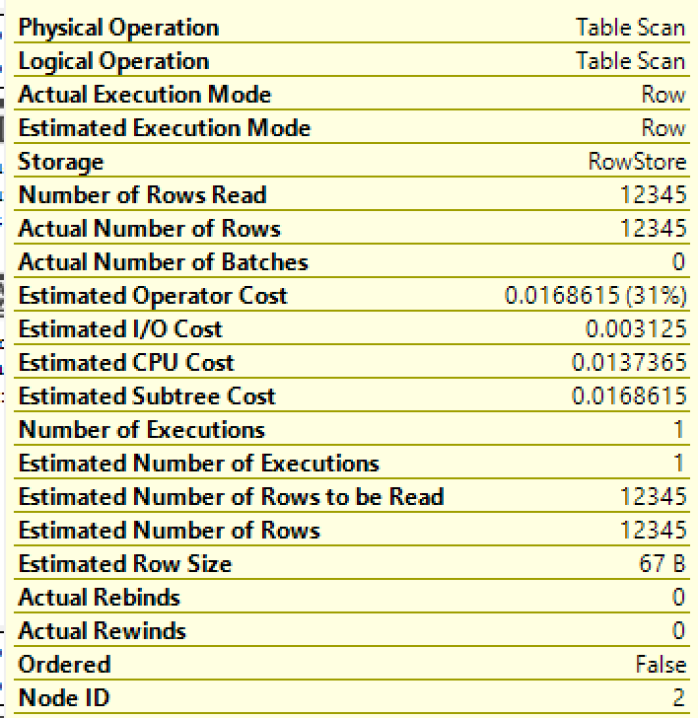
Interleaved Execution
Overview
Compatibility Level 120/130
Compatibility Level 140 or higher
During optimization if SQL Server encounter a read-only multi-statement table-valued function (MSTVF), it will pause optimization, execute the applicable subtree, capture accurate cardinality estimates, and then resume optimization for downstream operations.
Notes:
MSTVFs have a fixed cardinality guess of 100 starting with SQL Server 2014 (12.x), and 1 for earlier SQL Server versions. Interleaved execution helps workload performance issues that are due to these fixed cardinality estimates associated with MSTVFs.
With interleaved execution, the actual row counts from the function are used to make better-informed downstream query plan decisions. For more information on multi-statement table-valued functions (MSTVFs), see Table-valued functions.
Interleaved execution changes the unidirectional boundary between the optimization and execution phases for a single-query execution and enables plans to adapt based on the revised cardinality estimates. During optimization if we encounter a candidate for interleaved execution, which is currently multi-statement table-valued functions (MSTVFs), we will pause optimization, execute the applicable subtree, capture accurate cardinality estimates, and then resume optimization for downstream operations.
MSTVF referencing statements in interleaved execution must currently be read-only and not part of a data modification operation. Also, MSTVFs are not eligible for interleaved execution if they do not use runtime constants.
Interleaved execution eligible statements
MSTVF referencing statements in interleaved execution must currently be read-only and not part of a data modification operation. Also, MSTVFs are not eligible for interleaved execution if they do not use runtime constants.
Interleaved execution benefits
In general, the higher the skew between the estimated vs. actual number of rows, coupled with the number of downstream plan operations, the greater the performance impact. In general, interleaved execution benefits queries where:
There is a large skew between the estimated vs. actual number of rows for the intermediate result set (in this case, the MSTVF).
And the overall query is sensitive to a change in the size of the intermediate result. This typically happens when there is a complex tree above that subtree in the query plan. A simple SELECT * from an MSTVF will not benefit from interleaved execution.
Interleaved execution overhead
The overhead should be minimal-to-none.
Interleaved execution and consecutive executions
Once an interleaved execution plan is cached, the plan with the revised estimates on the first execution is used for consecutive executions without re-instantiating interleaved execution.
For further information refer to:
https://docs.microsoft.com/en-us/sql/relational-databases/performance/intelligent-query-processing#interleaved-execution-for-mstvfs

Slide 43
Interleaved Execution
Enabling/Disabling Interleaved Execution
Enabled by default in Compatibility level 140 or higher.
To disable change compatibility level to 130 or lower (not recommended).
You can enable/disable it at the database level
SQL Server 2017.
Azure SQL Database, SQL Server 2019 and higher
You can disable it at statement scope if necessary.
ALTER DATABASE SCOPED CONFIGURATION SET DISABLE_INTERLEAVED_EXECUTION_TVF = ON|OFF;
ALTER DATABASE SCOPED CONFIGURATION SET INTERLEAVED_EXECUTION_TVF = ON|OFF;
<statement>
OPTION (USE HINT('DISABLE_INTERLEAVED_EXECUTION_TVF'));

Slide 44
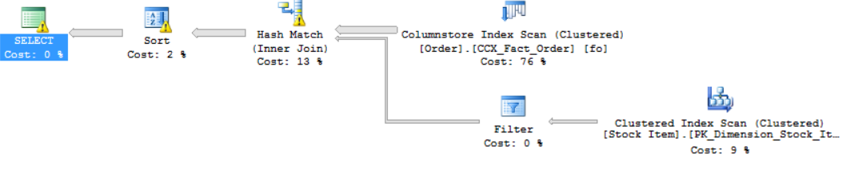
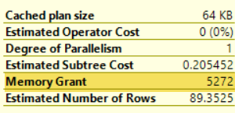
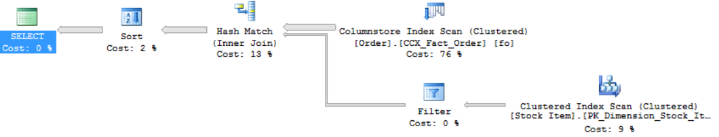
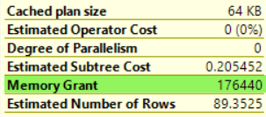
Memory Grant Feedback (Batch Mode)
By addressing repeating workloads, it recalculates the actual memory required for a query and then updates the grant value for the cached plan.
For parameter-sensitive plans, memory grant feedback will disable itself on a query if it has unstable memory requirements.
First Execution (Spills detected; feedback generated)
Second Execution (Memory grant adjusted)
Notes:
A query's post-execution plan in SQL Server includes the minimum required memory needed for execution and the ideal memory grant size to have all rows fit in memory. Performance suffers when memory grant sizes are incorrectly sized. Excessive grants result in wasted memory and reduced concurrency. Insufficient memory grants cause expensive spills to disk. By addressing repeating workloads, batch mode memory grant feedback recalculates the actual memory required for a query and then updates the grant value for the cached plan. When an identical query statement is executed, the query uses the revised memory grant size, reducing excessive memory grants that impact concurrency and fixing underestimated memory grants that cause expensive spills to disk.
For further information refer to:
https://docs.microsoft.com/en-us/sql/relational-databases/performance/intelligent-query-processing#batch-mode-memory-grant-feedback

Slide 45
Memory Grant Feedback (Batch Mode)
Enabling/Disabling Memory Grant Feedback (Batch Mode)
Enabled by default in Compatibility level 140 or higher.
To disable change compatibility level to 130 or lower (not recommended).
You can enable/disable it at the database level
SQL Server 2017.
Azure SQL Database, SQL Server 2019 and higher
You can disable it at statement scope if necessary.
ALTER DATABASE SCOPED CONFIGURATION SET DISABLE_BATCH_MODE_MEMORY_GRANT_FEEDBACK=ON|OFF;
ALTER DATABASE SCOPED CONFIGURATION SET BATCH_MODE_MEMORY_GRANT_FEEDBACK = ON|OFF;
<statement>
OPTION (USE HINT ('DISABLE_BATCH_MODE_MEMORY_GRANT_FEEDBACK'))

Slide 46
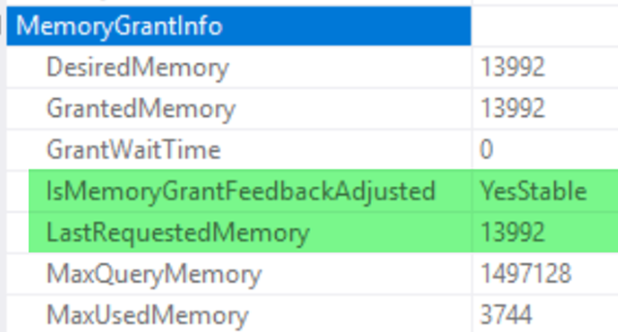
Memory Grant Feedback (Row Mode)
Overview
Expands on the batch mode memory grant feedback feature by also adjusting memory grant sizes for row mode operators.
Two new query plan attributes will be shown for actual post-execution plans:
IsMemoryGrantFeedbackAdjusted
LastRequestedMemory
Notes:
Introduced in SQL Server 2019
Row mode memory grant feedback expands on the batch mode memory grant feedback feature by adjusting memory grant sizes for both batch and row mode operators.
To enable row mode memory grant feedback in Azure SQL Database, enable database compatibility level 150 for the database you are connected to when executing the query.
Row mode memory grant feedback activity will be visible via the memory_grant_updated_by_feedback XEvent.
Starting with row mode memory grant feedback, two new query plan attributes will be shown for actual post-execution plans: IsMemoryGrantFeedbackAdjusted and LastRequestedMemory, which are added to the MemoryGrantInfo query plan XML element.
LastRequestedMemory shows the granted memory in Kilobytes (KB) from the prior query execution. IsMemoryGrantFeedbackAdjusted attribute allows you to check the state of memory grant feedback for the statement within an actual query execution plan.
For further information refer to:
https://docs.microsoft.com/en-us/sql/relational-databases/performance/intelligent-query-processing#row-mode-memory-grant-feedback

Slide 47
Memory Grant Feedback (Row Mode)
Enabling/Disabling Memory Grant Feedback (Batch Mode)
Enabled by default in Compatibility level 150 or higher.
To disable change compatibility level to 140 or lower (not recommended).
You can enable/disable it at the database level.
You can disable it at statement scope if necessary.
ALTER DATABASE SCOPED CONFIGURATION SET ROW_MODE_MEMORY_GRANT_FEEDBACK = ON|OFF;
<statement>
OPTION (USE HINT ('DISABLE_ROW_MODE_MEMORY_GRANT_FEEDBACK'));

Slide 48
Table Variable Deferred Compilation
Overview
Compilation of a statement that references a table variable is deferred until the first actual execution.
Performance may not be improved by this feature if the table variable row count varies significantly across executions.
Table variable deferred compilation doesn't change any other characteristics of table variables.
Table variable deferred compilation doesn't increase recompilation frequency.
Cached plan is generated based on the initial deferred compilation table variable row count instead of the original one-row guess.
Notes:
Table variable deferred compilation improves plan quality and overall performance for queries referencing table variables. During optimization and initial plan compilation, this feature will propagate cardinality estimates that are based on actual table variable row counts. This exact row count information will then be used for optimizing downstream plan operations.
With table variable deferred compilation, compilation of a statement that references a table variable is deferred until the first actual execution of the statement. This deferred compilation behavior is identical to the behavior of temporary tables. This change results in the use of actual cardinality instead of the original one-row guess.
To enable table variable deferred compilation, enable database compatibility level 150 for the database you're connected to when the query runs.
Table variable deferred compilation doesn't change any other characteristics of table variables. For example, this feature doesn't add column statistics to table variables.
Table variable deferred compilation doesn't increase recompilation frequency. Rather, it shifts where the initial compilation occurs. The resulting cached plan generates based on the initial deferred compilation table variable row count.
The cached plan is reused by consecutive queries. It's reused until the plan is evicted or recompiled.
Table variable row count that is used for initial plan compilation represents a typical value might be different from a fixed row count guess. If it's different, downstream operations will benefit. Performance may not be improved by this feature if the table variable row count varies significantly across executions.
For further information refer to:
https://docs.microsoft.com/en-us/sql/relational-databases/performance/intelligent-query-processing#table-variable-deferred-compilation

Slide 49
Table Variable Deferred Compilation
Enabling/Disabling Table Variable Deferred Compilation
Enabled by default in Compatibility level 150 or higher.
To disable change compatibility level to 140 or lower (not recommended).
You can enable/disable it at the database level.
You can disable it at statement scope if necessary.
ALTER DATABASE SCOPED CONFIGURATION SET DEFERRED_COMPILATION_TV = ON|OFF;
<table variable declaration>
<data inserted into table variable >
<statement that uses the table variable>
OPTION (USE HINT('DISABLE_DEFERRED_COMPILATION_TV'));

Slide 50
Approximate Count Distinct
Overview
Designed for use in big data scenarios and is optimized for the following conditions:
Access of data sets that are millions of rows or higher and
Aggregation of a column or columns that have many distinct values
APPROX_COUNT_DISTINCT
It returns the approximate number of unique non-null values in a group.
It is designed to provide aggregations across large data sets where responsiveness is more critical than absolute precision.
Its implementation guarantees up to a 2% error rate within a 97% probability.
requires less memory than an exhaustive COUNT DISTINCT operation so it is less likely to spill memory to disk compared to COUNT DISTINCT.
Notes:
Introduced in SQL Server 2019
It aggregates across large datasets where responsiveness is more critical than absolute precision. An example is calculating a COUNT(DISTINCT()) across 10 billion rows, for display on a dashboard. In this case, absolute precision isn't important, but responsiveness is critical. The new APPROX_COUNT_DISTINCT aggregate function returns the approximate number of unique non-null values in a group.
Example scenario:
Calculating a COUNT(DISTINCT()) across 10 billion rows, for display on a dashboard. If absolute precision isn't important, but responsiveness is critical, the function APPROX_COUNT_DISTINCT can be a better option in this scenario.
For further information refer to:
https://docs.microsoft.com/en-us/sql/relational-databases/performance/intelligent-query-processing#approximate-query-processing
https://docs.microsoft.com/en-us/sql/t-sql/functions/approx-count-distinct-transact-sql

Slide 51
Batch Mode on RowStore
Overview
Even if a query does not access any tables with ColumnStore indexes, the query processor, using heuristics, will decide whether to consider batch mode.
If batch mode on rowstore is used, you see the actual run mode as batch mode in the query plan.
CPU consumption Reduced
No gain in I/O consumption unless data is already in cache
Performance improvement only possible if enough memory to cache all data
Notes:
Query plans don't always use batch mode. The Query Optimizer might decide that batch mode isn't beneficial for the query.
The two sets of features work together to improve input/output (I/O) and CPU utilization:
By using ColumnStore indexes, more of your data fits in memory. That reduces the I/O workload.
Batch mode processing uses CPU more efficiently.
Workloads that might benefit from batch mode on rowstore
The following workloads might benefit from batch mode on rowstore:
A significant part of the workload consists of analytical queries. Usually, these queries use operators like joins or aggregates that process hundreds of thousands of rows or more.
The workload is CPU bound. If the bottleneck is I/O, it is still recommended that you consider a ColumnStore index, where possible.
Creating a ColumnStore index adds too much overhead to the transactional part of your workload. Or, creating a ColumnStore index is not feasible because your application depends on a feature that's not yet supported with ColumnStore indexes.
For further information refer to:
https://docs.microsoft.com/en-us/sql/relational-databases/performance/intelligent-query-processing#batch-mode-on-rowstore

Slide 52
Batch Mode on Rowstore
Enabling/Disabling Batch Mode on Rowstore
Enabled by default in Compatibility level 150 or higher.
To disable change compatibility level to 140 or lower (not recommended).
You can enable/disable it at the database level.
You can disable it at statement scope if necessary.
Enable it at statement scope (even with the feature disabled at database level).
ALTER DATABASE SCOPED CONFIGURATION SET BATCH_MODE_ON_ROWSTORE = ON|OFF;
<statement>
OPTION(RECOMPILE, USE HINT('DISALLOW_BATCH_MODE'));
<statement>
OPTION(RECOMPILE, USE HINT('ALLOW_BATCH_MODE'));

Slide 53
Scalar UDF Inlining
T-SQL Scalar UDF performance issues
Iterative invocation: Invoked once per qualifying row. Repeated context switching – and even worse for UDFs that execute SQL queries in their definition.
Lack of costing: Scalar operators are not costed (realistically).
Interpreted execution: Each statement itself is compiled, and the compiled plan is cached. No cross-statement optimizations are carried out.
Serial execution: SQL Server does not allow intra-query parallelism in queries that invoke UDFs.

Slide 54
Scalar UDF Inlining
Overview
The goal is to improve performance of queries that invoke T-SQL scalar UDFs, where UDF execution is the main bottleneck.
A scalar T-SQL UDF can not always be inline as conditions apply.
Scalar UDFs are automatically transformed into scalar expressions or scalar subqueries that are substituted in the calling query in place of the UDF operator.
These expressions and subqueries are then optimized. As a result, the query plan will no longer have a user-defined function operator, but its effects will be observed in the plan, like views or inline TVFs.
Notes:
For further information refer to:
https://docs.microsoft.com/en-us/sql/relational-databases/user-defined-functions/scalar-udf-inlining

Slide 55
Scalar UDF Inlining
Enabling/Disabling Scalar UDF Inlining
Enabled by default in Compatibility level 150 or higher.
To disable change compatibility level to 140 or lower (not recommended).
You can enable/disable it at the database level.
You can disable it at statement scope if necessary.
ALTER DATABASE SCOPED CONFIGURATION SET TSQL_SCALAR_UDF_INLINING = ON|OFF;
<statement>
OPTION (USE HINT('DISABLE_TSQL_SCALAR_UDF_INLINING'));

Slide 56
Demonstration
Intelligent query processing
Interleaved Execution
Batch Mode on RowStore
Memory Grant Feedback (Row Mode)
Notes:
M07L04Demo01
Go to the Lab VM
Go through e:\Demos\M07L04Demo01\aqp_interleaved.sql
Go through e:\Demos\M07L04Demo01\iqp_batchmoderow.sql
Go through e:\Demos\M07L04Demo01\iqp_rowmodemfg.sql

Slide 57
Intelligent query processing
Observing Batch-Mode Memory Grant Feedback
Using APPROX_COUNT_DISTINCT to improve performance
Observing Table Variable Deferred Compilation
Observing Scalar UDF Inlining
Notes:
M07L04Lab01

Slide 58
Questions?

Slide 59
Knowledge Check
Is it possible to disable Intelligent Query Processing features?
On queries not using Interleaved execution for MSTVFs. How many rows are estimated for a MSTVFs?
On queries not using table variable deferred compilation. How many rows are estimated for a table variable?
Does table variable deferred compilation increase the recompilation frequency?
What is the minimum compatibility level that supports Batch mode on rowstore?
Notes:
Q1: Is it possible to disable Intelligent Query Processing features?
A1: Yes, you can disable all IQP features by reducing the compatibility level of the database. In some cases you can use ALTER DATABASE SCOPED CONFIGURATION to disable the feature and you can also use query hits to disable the feature at sentence level.
Q2: On queries not using Interleaved execution for MSTVFs. How many rows are estimated for a MSTVFs?
A2: MSTVFs have a fixed cardinality guess of 100 starting with SQL Server 2014 (12.x), and 1 for earlier SQL Server versions.
Q3 Does table variable deferred compilation increase the recompilation frequency?
A3: Table variable deferred compilation doesn't increase recompilation frequency. Rather, it shifts where the initial compilation occurs. The resulting cached plan generates based on the initial deferred compilation table variable row count.
Q4: On queries not using table variable deferred compilation. How many rows are estimated for a table variable?
A4: A fixed guess of 1 row
Q5: What is the minimum compatibility level that supports Batch mode on rowstore?
A5: 150

